Slide 1

RUBIKS CUBE SOLVER
GROUP 8
Alekhya Ettedi
Venkata Sai Chaitanya Reddy Gangireddy

Slide 2
CONTENTS
Abstract
Introduction
Objective
Project Approach
Conclusion
References

Slide 3
ABSTRACT
Rubik's Cube solution using reinforcement learning technique.
With a single objective state and a wide state space, this classic combinatorial puzzle presents a significant challenge for artificial intelligence. It is unlikely for any randomly produced sequence to attain the desired state.
Our method combines deep learning with classic reinforcement learning and path finding methods.
We have successfully resolved every test configuration to reach the desired state by combining it with the algorithm.

Slide 4
INTRODUCTION
The Rubik’s Cube is a well know combination game, that has tempted the minds of AI researches for a long time.
The Rubik’s cube has a large state space with approximately 4.3 × 1019 (43,252,003,274,489,856,000) different states. Out of them only one is the goal state.
There are a lot of other solving methods (e.g. Kociemba, Korf, etc.) but, using these techniques would be an interesting approach to solving the Rubik’s cube.

Slide 5
OBJECTIVE
A classic combinatorial puzzle having a big state space and a single goal state is the Rubik's cube. There are special hurdles for machine learning because it is improbable that the goal state can be reached with a series of randomly produced moves.
Rubik's Cube can be solved using pattern-based databases, although these techniques can be memory-intensive and puzzle-specific.
Without utilizing human input, reinforcement learning algorithms have recently produced superhuman outcomes in games with much bigger state spaces such as Go , Chess, and Shogi.

Slide 6
PROJECT APPROACH
Initially, the cube’s faces are colored in different colors each. We're tackling the Rubik's Cube puzzle using reinforcement learning.
The Rubick's Cube puzzle is a Markov Decision Process in a deterministic episodic context, as seen through the lens of reinforcement learning. The cube represents the state of the environment, all motions are feasible actions, and there are only two possible outcomes: -1 or 1. The resolved state is the final state.
The project's assumption that a Rubik's cube can only do 180-degree side turns significantly lowers the state space tree of the cube's branching factor.

Slide 7

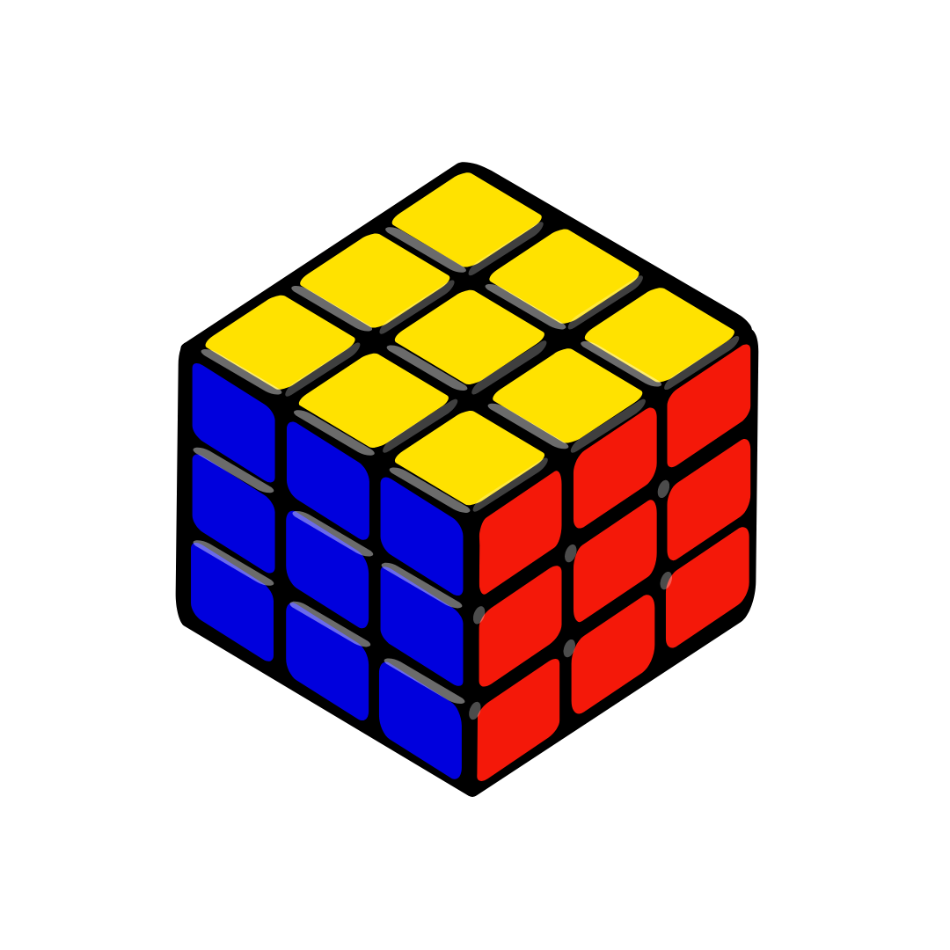
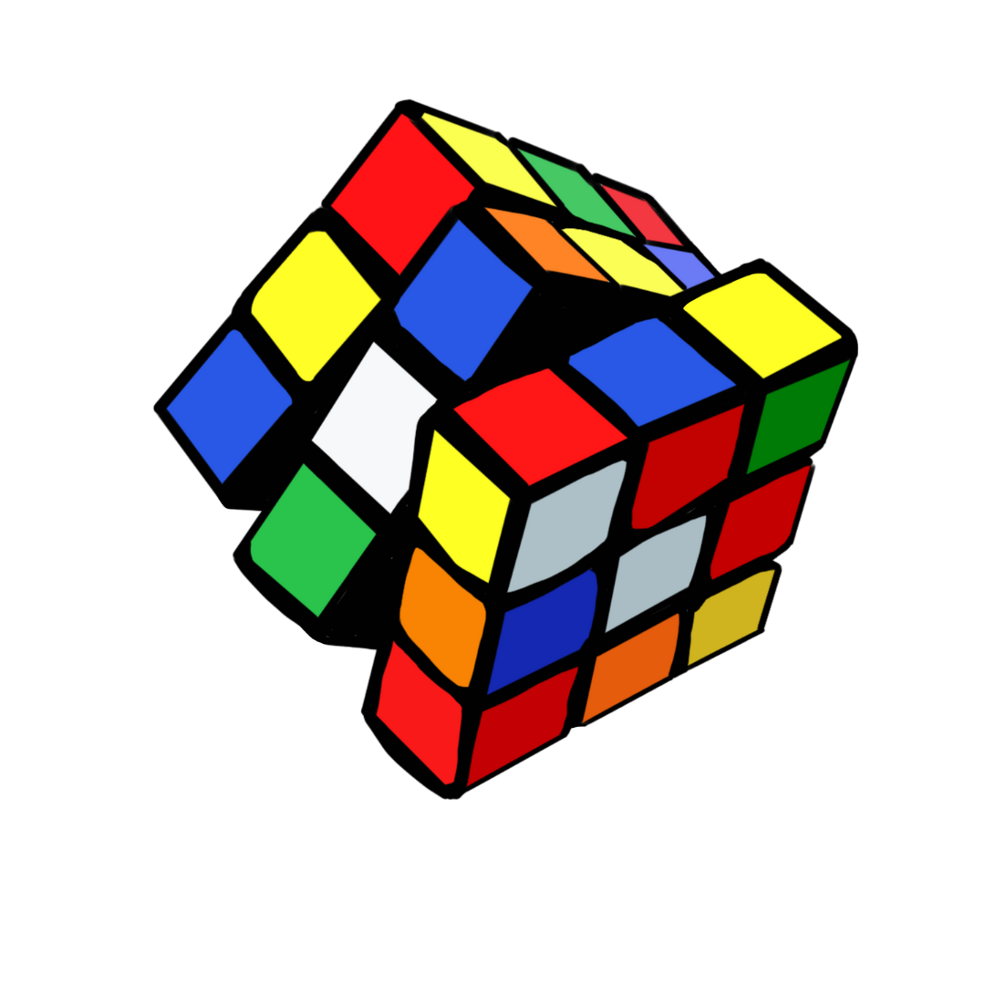
PROJECT APPROACH
A reinforcement learning algorithm such as Deep Q-Networks using a simulated Rubik's Cube environment. The algorithm iteratively explores actions and learns optimal strategies to maximize cumulative rewards.

Slide 8
PROJECT APPROACH
puzzle.py provides a few auxiliary functions that are utilized in other places in the program, along with State(), the state representation of a Rubik's Cube.
test.py and others.py contains a range of test cases that can be run to verify that the cube's state representation is implemented correctly.
Agent.py entails the use of a pattern database in conjunction with the implementation of a reinforcement learning agent to create a Q-Table, which is then used to attempt solving the random Rubik's cube.

Slide 9
CONCLUSION
In conclusion, solving the Rubik's Cube using reinforcement learning approaches offers a viable path toward expanding our knowledge of artificial intelligence's capacity for complicated problem-solving. Reinforcement learning algorithms can progressively find effective tactics for solving the Rubik's Cube through iterative learning and exploration; these strategies frequently surpass conventional methods.

Slide 10
REFERENCES
T. Rokicki and M. Davidson, “God’s number is 26 in the quarter-turn metric,” (2014).
R. E. Korf, “Finding optimal solutions to Rubik's cube using pattern databases,” (1997).
D. Silver, J. Schrittwieser, et al., “Mastering the game of go without human knowledge,” (2017).
F. Agostinelli, S. McAleer, et al., “Solving the Rubik's cube with deep reinforcement learning and search,” (2019).

